Slide 1
Transformers & Modern Variants
Vanilla Transformer · Mistral 7 B · 8 × 7 B MoE

Slide 2
Agenda
Transformer vs Mistral – key design deltas
Sliding-window attention & receptive field
KV-cache & rolling buffer
Sparse Mixture of Experts (8 × 7 B)
Sharding, pipeline & prompt batching

Slide 3
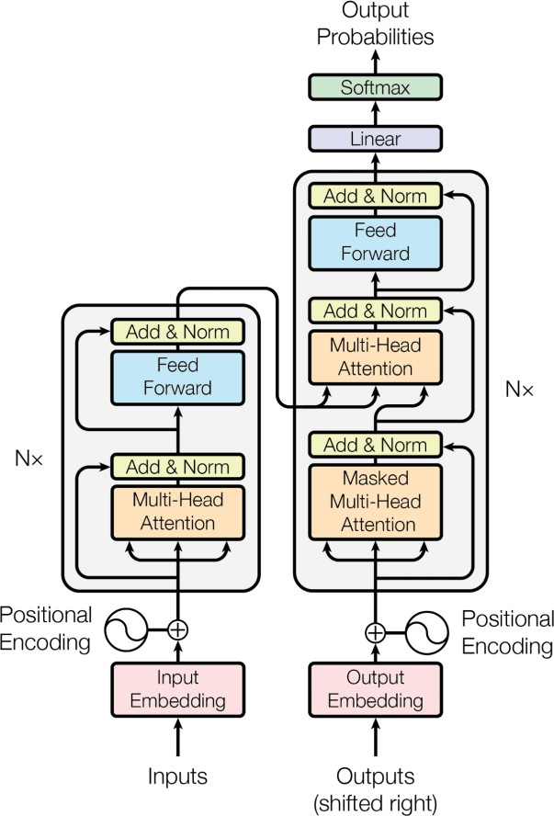

Transformer vs Mistral (7 B & 8 × 7 B)
Softmax
Linear
RMS Norm
(MoE) Feed Forward
SILU
RMS Norm
Nx
Self-Attention with Sliding Window Attention
,Grouped Query Attention, and Rolling Buffer KV- Cache
Q K
V
Rotary
Positional Encodings
RMS Norm
Embeddings
Input
Transformer
(“Attention is all you need”)
Mistral

Slide 4
Model Hyper-Parameters
Parameter | Description | Value (7 B) | Value (8 × 7 B) | Notes
dim | Size of the embedding vector | 4096 | 4096 | —
n_layers | Number of encoder layers | 32 | 32 | —
head_dim | dim / n_heads | 128 | 128 | —
hidden_dim | Hidden dimension in the feed-forward layer | 14 336 | 14 336 | —
n_heads | Number of attention heads (Q) | 32 | 32 | Different KV split because of GQA
n_kv_heads | Number of attention heads (K, V) | 8 | 8 | —
window_size | Sliding-window span for attention & rolling cache | 4096 | N /A | window_size not set in 8 × 7 B params.json
context_len | Context length used during training | 8192 | 32 000 | 8 × 7 B value from announcement page
vocab_size | Tokens in the vocabulary | 32 000 | 32 000 | SentencePiece tokenizer
num_experts_per_tok | Expert models selected per token | N /A | 2 | Sparse MoE only in 8 × 7 B
num_experts | Total number of experts | N /A | 8 | —

Slide 5
Self-Attention
Self-Attention allows the model to relate words to each other. Imagine we have the following sentence: “The cat is on a chair”
Here I show the product of the Q and the K matrix before we apply the SoftMax.
𝐴𝑡𝑡𝑒𝑛𝑡𝑖𝑜𝑛 𝑄, 𝐾, 𝑉
= softmax
𝑄𝐾^{𝑇}
𝑉
 | THE | CAT | IS | ON | A | CHAIR
THE | 0.268 | 0.119 | 0.134 | 0.148 | 0.179 | 0.152
CAT | 0.124 | 0.278 | 0.201 | 0.128 | 0.154 | 0.115
IS | 0.147 | 0.132 | 0.262 | 0.097 | 0.218 | 0.145
ON | 0.210 | 0.128 | 0.206 | 0.212 | 0.119 | 0.125
A | 0.146 | 0.158 | 0.152 | 0.143 | 0.227 | 0.174
CHAIR | 0.195 | 0.114 | 0.203 | 0.103 | 0.157 | 0.229
𝑑_{𝑘}
Q
(6, 4096)
_{K}T
(4096, 6)
X
=
* all values are random.
4096
(6, 6)

Slide 6
Causal Mask
After applying the causal mask, we apply the SoftMax, which makes the remaining values on the row in such a way that the row sums up to 1.
Now, let’s look at the sliding window attention.
𝐴𝑡𝑡𝑒𝑛𝑡𝑖𝑜𝑛 𝑄, 𝐾, 𝑉
= softmax
𝑄𝐾^{𝑇}
𝑉
 | THE | CAT | IS | ON | A | CHAIR
THE | 0.268 | −∞ | −∞ | −∞ | −∞ | −∞
CAT | 0.124 | 0.278 | −∞ | −∞ | −∞ | −∞
IS | 0.147 | 0.132 | 0.262 | −∞ | −∞ | −∞
ON | 0.210 | 0.128 | 0.206 | 0.212 | −∞ | −∞
A | 0.146 | 0.158 | 0.152 | 0.143 | 0.227 | −∞
CHAIR | 0.195 | 0.114 | 0.203 | 0.103 | 0.157 | 0.229
𝑑_{𝑘}
Q
(6, 4096)
_{K}T
(4096, 6)
X
=
* all values are random.
4096
(6, 6)

Slide 7
Sliding-Window Attention
The sliding window size is 3
𝐴𝑡𝑡𝑒𝑛𝑡𝑖𝑜𝑛 𝑄, 𝐾, 𝑉
= softmax
𝑄𝐾^{𝑇}
𝑉
𝑑_{𝑘}
 | THE | CAT | IS | ON | A | CHAIR
THE | 0.268 | −∞ | −∞ | −∞ | −∞ | −∞
CAT | 0.124 | 0.278 | −∞ | −∞ | −∞ | −∞
IS | 0.147 | 0.132 | 0.262 | −∞ | −∞ | −∞
ON | −∞ | 0.128 | 0.206 | 0.212 | −∞ | −∞
A | −∞ | −∞ | 0.152 | 0.143 | 0.227 | −∞
CHAIR | −∞ | −∞ | −∞ | 0.103 | 0.157 | 0.229
Q
(6, 4096)
_{K}T
(4096, 6)
X
=
* all values are random.
4096
(6, 6)

Slide 8
Sliding Window Attention: Takeaways
Reduces the number of dot-products to perform, and thus, performance during training and inference.
Sliding window attention may lead to degradation in the performance of the model, as some “interactions” between tokens will not be captured.
The model mostly focuses on the local context, which depending on the size of the window, is enough for most cases.
This makes sense if you think about a book: the words in a paragraph on chapter number 5 depend on the paragraphs in the same chapter but may be totally unrelated to the words used in chapter 1.
Sliding window attention can still allow one token to watch tokens outside the window, using a reasoning similar to the receptive field in convolutional neural networks.

Slide 9
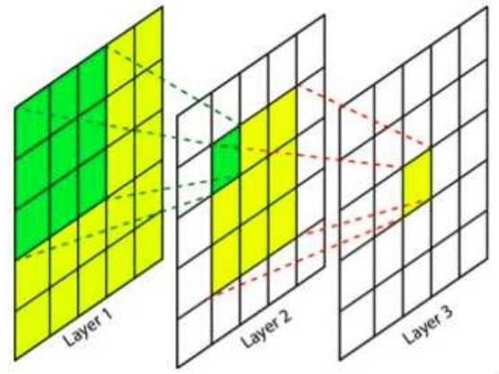
Receptive field in CNNs
This feature depends directly on 9 features of the previous layers, but indirectly on all the features of the initial layers, since each feature of the intermediate layer depends on 9 features of the previous layer. This means that a change in any of the features of the layer 1 will influence this features as well.

Slide 10
Sliding Window Attention: Information Flow (1)
After applying the softmax, all the –Infinity have become 0, while the other values in the row are changed in such a way that they sum up to one. The output of the softmax can be thought of as a probability distribution.
𝐴𝑡𝑡𝑒𝑛𝑡𝑖𝑜𝑛 𝑄, 𝐾, 𝑉
= softmax
𝑄𝐾^{𝑇}
𝑉
𝑑_{𝑘}
 | THE | CAT | IS | ON | A | CHAIR
THE | 1.0 | 0 | 0 | 0 | 0 | 0
CAT | 0.461 | 0.538 | 0 | 0 | 0 | 0
IS | 0.3219 | 0.317 | 0.361 | 0 | 0 | 0
ON | 0 | 0.316 | 0.341 | 0.343 | 0 | 0
A | 0 | 0 | 0.326 | 0.323 | 0.351 | 0
CHAIR | 0 | 0 | 0 | 0.313 | 0.331 | 0.356
Q
X
_{K}T
SoftMax
=
(6, 4096)
(4096, 6)
4096

Slide 11
Sliding Window Attention: Information Flow (2)
The output of the Self-Attention is a matrix of the same shape as the input sequence, but where each token now captures information about other tokens according to the mask applied. In our case, the last token of the output captures information about itself and the two preceding tokens.
 | THE | CAT | IS | ON | A | CHAIR
THE | 1.0 | 0 | 0 | 0 | 0 | 0
CAT | 0.461 | 0.538 | 0 | 0 | 0 | 0
IS | 0.3219 | 0.317 | 0.361 | 0 | 0 | 0
ON | 0 | 0.316 | 0.341 | 0.343 | 0 | 0
A | 0 | 0 | 0.326 | 0.323 | 0.351 | 0
CHAIR | 0 | 0 | 0 | 0.313 | 0.331 | 0.356
𝐴𝑡𝑡𝑒𝑛𝑡𝑖𝑜𝑛 𝑄, 𝐾, 𝑉 = softmax
𝑄𝐾^{𝑇}
𝑉
𝑑_{𝑘}
V
(6, 4096)
Output
(6, 4096)
X
=
(6, 6)

Slide 12
Sliding Window Attention: Information Flow (3)
With a sliding window size 𝑊 = 3, every layer adds information about (𝑊 – 1) = 2 tokens.
This means that after 𝑁 layers, we will have an information flow in the order of 𝑊 × 𝑁.
You can test all the future configurations using the Python Notebook provided in the GitHub repository.
THE
CAT
IS
ON
A
CHAIR
THE
THE, CAT
THE, CAT, IS
CAT, IS, ON
IS, ON, A
ON, A, CHAIR
THE
THE, CAT
THE, CAT, IS
THE, CAT, IS, ON
THE, CAT, IS, ON, A
CAT, IS, ON, A, CHAIR
Layer 1
Layer 2
(6, 4096)
(6, 4096)
(6, 4096)

Slide 13
Sliding Window Attention: Information Flow (4)
 | THE | THE/CAT | THE/CAT /IS | CAT/IS/ ON | IS/ON/A | ON/A/C HAIR
THE | 1.0 | 0 | 0 | 0 | 0 | 0
THE/CA T | 0.461 | 0.538 | 0 | 0 | 0 | 0
THE/CA T/IS | 0.3219 | 0.317 | 0.361 | 0 | 0 | 0
CAT/IS/ ON | 0 | 0.316 | 0.341 | 0.343 | 0 | 0
IS/ON/ A | 0 | 0 | 0.326 | 0.323 | 0.351 | 0
ON/A/C HAIR | 0 | 0 | 0 | 0.313 | 0.331 | 0.356
V
(6, 4096)
Output
(6, 4096)
X
=
(6, 6)

Slide 14
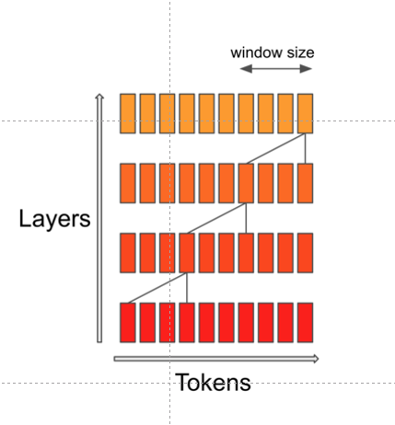
Sliding Window Attention: Information Flow (5)
As you can see, the information flow is very similar to the receptive field of a CNN.

Slide 15
Sliding Window Attention: Information Flow (5)
Softmax
Imagine we want to train a model to write Dante Alighieri’s Divine Comedy’s 5th Canto from the Inferno.
Amor, ch'al cor gentil ratto s'apprende, prese costui de la bella persona
che mi fu tolta; e 'l modo ancor m'offende.
Amor, ch'a nullo amato amar perdona, mi prese del costui piacer sì forte,
che, come vedi, ancor non m'abbandona.
Amor condusse noi ad una morte. Caina attende chi a vita ci spense.
Love, that can quickly seize the gentle heart, took hold of him because of the fair body
taken from me—how that was done still wounds me.
Love, that releases no beloved from loving, took hold of me so strongly through his beauty that, as you see, it has not left me yet.
Love led the two of us unto one death. Caina waits for him who took our life.”
Linear
RMS Norm
(MoE) Feed Forward
SILU
RMS Norm
Nx
Self-Attention with Sliding Window Attention
,Grouped Query Attention, and Rolling Buffer KV- Cache
Q K
V
Rotary
Positional Encodings
RMS Norm
Embeddings
Input

Slide 16
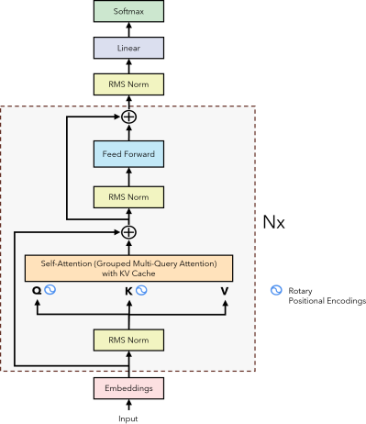
Next Token Prediction Task
Target Love that can quickly seize the gentle heart [EOS]
Training
Input :
[SOS] Love that can quickly seize the gentle heart

Slide 17
Next Token Prediction Task
Output Love
Inference T = 1
Input :
[SOS]

Slide 18
Next Token Prediction Task
Output Love that
Inference T = 2
Input :
[SOS] Love

Slide 19
Next Token Prediction Task
Output Love that can
Inference T = 3
Input :
[SOS] Love that

Slide 20
Next Token Prediction Task
Output Love that can quickly
Inference T = 4
Input :
[SOS] Love that can

Slide 21
Next Token Prediction Task
Output Love that can quickly seize
Inference T = 5
Input :
[SOS] Love that can quickly

Slide 22
Next Token Prediction Task
Output Love that can quickly seize the
Inference T = 6
Input :
[SOS] Love that can quickly seize

Slide 23
Next Token Prediction Task
Output Love that can quickly seize the gentle
Inference T = 7
Input :
[SOS] Love that can quickly seize the

Slide 24
Next Token Prediction Task
Output Love that can quickly seize the gentle heart
Inference T = 8
Input :
[SOS] Love that can quickly seize the gentle

Slide 25
Next Token Prediction Task
Output Love that can quickly seize the gentle heart [EOS]
Inference T = 9
Input :
[SOS] Love that can quickly seize the gentle heart

Slide 26
Next Token Prediction Task: the motivation behind the KV cache
At every step of the inference, we are only interested in the last token output by the model, because we already have the previous ones. However, the model needs access to all the previous tokens to decide on which token to output, since they constitute its context (or the “prompt”).
Is there a way to make the model do less computation on the token it has already seen during inference? YES! The solution is the KV cache!

Slide 27
Self-Attention during Next Token Prediction Task
𝑄𝐾^{𝑇}
_{𝐾}𝑇
T 1 - T 1 | T 1- T 1 | T 1 - T 1 | T 1 - T 1 | T 1 - T 1 | T 1 - T 1 | T 1 - T 1 | T 1 - T 1 | T 1 - T 1
T 1 - T 1 | T 1- T 1 | T 1 - T 1 | T 1 - T 1 | T 1 - T 1 | T 1 - T 1 | T 1 - T 1 | T 1 - T 1 | T 1 - T 1
T 1 - T 1 | T 1- T 1 | T 1 - T 1 | T 1 - T 1 | T 1 - T 1 | T 1 - T 1 | T 1 - T 1 | T 1 - T 1 | T 1 - T 1
T 1 - T 1 | T 1- T 1 | T 1 - T 1 | T 1 - T 1 | T 1 - T 1 | T 1 - T 1 | T 1 - T 1 | T 1 - T 1 | T 1 - T 1
T 1 - T 1 | T 1- T 1 | T 1 - T 1 | T 1 - T 1 | T 1 - T 1 | T 1 - T 1 | T 1 - T 1 | T 1 - T 1 | T 1 - T 1
T 1 - T 1 | T 1- T 1 | T 1 - T 1 | T 1 - T 1 | T 1 - T 1 | T 1 - T 1 | T 1 - T 1 | T 1 - T 1 | T 1 - T 1
T 1 - T 1 | T 1- T 1 | T 1 - T 1 | T 1 - T 1 | T 1 - T 1 | T 1 - T 1 | T 1 - T 1 | T 1 - T 1 | T 1 - T 1
T 1 - T 1 | T 1- T 1 | T 1 - T 1 | T 1 - T 1 | T 1 - T 1 | T 1 - T 1 | T 1 - T 1 | T 1 - T 1 | T 1 - T 1
T 1 - T 1 | T 1- T 1 | T 1 - T 1 | T 1 - T 1 | T 1 - T 1 | T 1 - T 1 | T 1 - T 1 | T 1 - T 1 | T 1 - T 1
𝑄
𝑉
𝐴𝑡𝑡𝑒𝑛𝑡𝑖𝑜𝑛
TOKEN 1
TOKEN 2
TOKEN 3
TOKEN 4
TOKEN 5
TOKEN 6
TOKEN 7
TOKEN 8
TOKEN 9
TOKEN 1
TOKEN 2
TOKEN 3
TOKEN 4
TOKEN 5
TOKEN 6
TOKEN 7
TOKEN 8
TOKEN 9
OUTPUT TOKEN 1
OUTPUT TOKEN 2
OUTPUT TOKEN 3
OUTPUT TOKEN 4
OUTPUT TOKEN 5
OUTPUT TOKEN 6
OUTPUT TOKEN 7
OUTPUT TOKEN 8
OUTPUT TOKEN 9
T O K E N 1 | T O K E N 2 | T O K E N 3 | T O K E N 4 | T O K E N 5 | T O K E N 6 | T O K E N 7 | T O K E N 8 | T O K E N 9
𝑋
=
𝑋
=
(9, 4096)
(4096, 9)
(9, 4096)
(9, 4096)
𝑄𝐾^{𝑇}
𝐴𝑡𝑡𝑒𝑛𝑡𝑖𝑜𝑛 𝑄, 𝐾, 𝑉
= softmax
𝑉
(9, 9)
𝑑_{𝑘}

Slide 28
Inference T = 1
𝑄𝐾^{𝑇}
_{𝐾}𝑇
T 1 - T 1
𝑄
𝑉
𝐴𝑡𝑡𝑒𝑛𝑡𝑖𝑜𝑛
TOKEN 1
TOKEN 1
OUTPUT TOKEN 1
T O K E N 1
𝑋
=
𝑋
=
(1, 4096)
(4096, 1)
(1, 4096)
(1, 4096)
𝑄𝐾^{𝑇}
𝐴𝑡𝑡𝑒𝑛𝑡𝑖𝑜𝑛 𝑄, 𝐾, 𝑉
= softmax
𝑉
𝑑_{𝑘}
(1, 1)

Slide 29
Inference T = 2
𝑄𝐾^{𝑇}
_{𝐾}𝑇
T 1 - T 1 | T 1 - T 2
T 2 - T 1 | T 2 - T 2
𝑉
𝐴𝑡𝑡𝑒𝑛𝑡𝑖𝑜𝑛
𝑄
TOKEN 1
TOKEN 2
TOKEN 1
TOKEN 2
OUTPUT TOKEN 1
OUTPUT TOKEN 2
T O K E N 1 | T O K E N 2
𝑋
=
𝑋
=
(2, 4096)
(4096, 2)
(2, 4096)
(2, 4096)
𝑄𝐾^{𝑇}
𝑑_{𝑘}
𝐴𝑡𝑡𝑒𝑛𝑡𝑖𝑜𝑛 𝑄, 𝐾, 𝑉
= softmax
𝑉
(2, 2)

Slide 30
Inference T = 3
𝑄𝐾^{𝑇}
_{𝐾}𝑇
T 1 - T 1 | T 1 - T 2 | T 1 - T 3
T 2 - T 1 | T 2 - T 2 | T 2 - T 3
T 3 - T 1 | T 3 - T 2 | T 3 - T 3
𝑄
𝑉
𝐴𝑡𝑡𝑒𝑛𝑡𝑖𝑜𝑛
TOKEN 1
TOKEN 2
TOKEN 3
T O K E N 1 | T O K E N 2 | T O K E N 3
TOKEN 1
TOKEN 2
TOKEN 3
OUTPUT TOKEN 1
OUTPUT TOKEN 2
OUTPUT TOKEN 3
𝑋
=
𝑋
=
(3, 4096)
(4096, 3)
(3, 4096)
(3, 4096)
𝑄𝐾^{𝑇}
𝑑_{𝑘}
𝐴𝑡𝑡𝑒𝑛𝑡𝑖𝑜𝑛 𝑄, 𝐾, 𝑉
= softmax
𝑉
(3, 3)

Slide 31
Inference T = 4
𝑄𝐾^{𝑇}
_{𝐾}𝑇
T 1 - T 1 | T 1 - T 2 | T 1 - T 3 | T 1 - T 4
T 2 - T 1 | T 2 - T 2 | T 2 - T 3 | T 2 - T 4
T 3 - T 1 | T 3 - T 2 | T 3 - T 3 | T 3 - T 4
T 4 - T 1 | T 4 - T 2 | T 4 - T 3 | T 4 - T 4
𝑄
𝑉
𝐴𝑡𝑡𝑒𝑛𝑡𝑖𝑜𝑛
TOKEN 1
TOKEN 2
TOKEN 3
TOKEN 4
TOKEN 1
TOKEN 2
TOKEN 3
TOKEN 4
OUTPUT TOKEN 1
OUTPUT TOKEN 2
OUTPUT TOKEN 3
OUTPUT TOKEN 4
T O K E N 1 | T O K E N 2 | T O K E N 3 | T O K E N 4
𝑋
=
𝑋
=
(4, 4096)
(4096, 4)
(4, 4096)
(4, 4096)
𝑄𝐾^{𝑇}
𝑑_{𝑘}
𝐴𝑡𝑡𝑒𝑛𝑡𝑖𝑜𝑛 𝑄, 𝐾, 𝑉
= softmax
𝑉
(4, 4)

Slide 32
1. We already computed these dot products In the previous steps. Can we cache them?
2. Since the model is causal, we don’t care about the attention
of a token with its successors, but only with the tokens before it.
3. We don’t care about these, as we want to predict the next token and we already predicted the previous ones.
𝑄𝐾^{𝑇}
_{𝐾}𝑇
T 1 - T 1 | T 1 - T 2 | T 1 - T 3 | T 1 - T 4
T 2 - T 1 | T 2 - T 2 | T 2 - T 3 | T 2 - T 4
T 3 - T 1 | T 3 - T 2 | T 3 - T 3 | T 3 - T 4
T 4 - T 1 | T 4 - T 2 | T 4 - T 3 | T 4 - T 4
4. We are only interested In this last row!
𝑄
𝑉
𝐴𝑡𝑡𝑒𝑛𝑡𝑖𝑜𝑛
TOKEN 1
TOKEN 2
TOKEN 3
TOKEN 4
TOKEN 1
TOKEN 2
TOKEN 3
TOKEN 4
OUTPUT TOKEN 1
OUTPUT TOKEN 2
OUTPUT TOKEN 3
OUTPUT TOKEN 4
T O K E N 1 | T O K E N 2 | T O K E N 3 | T O K E N 4
𝑋
=
𝑋
=
(4, 4096)
(4096, 4)
(4, 4096)
(4, 4096)
𝑄𝐾^{𝑇}
𝑑_{𝑘}
Inference T = 4
𝐴𝑡𝑡𝑒𝑛𝑡𝑖𝑜𝑛 𝑄, 𝐾, 𝑉
= softmax
𝑉
(4, 4)

Slide 33


Slide 34
Self-Attention during Next Token Prediction Task
𝑄𝐾^{𝑇}
_{𝐾}𝑇
T 1 - T 1 | T 1- T 1 | T 1 - T 1 | T 1 - T 1 | T 1 - T 1 | T 1 - T 1 | T 1 - T 1 | T 1 - T 1 | T 1 - T 1
T 1 - T 1 | T 1- T 1 | T 1 - T 1 | T 1 - T 1 | T 1 - T 1 | T 1 - T 1 | T 1 - T 1 | T 1 - T 1 | T 1 - T 1
T 1 - T 1 | T 1- T 1 | T 1 - T 1 | T 1 - T 1 | T 1 - T 1 | T 1 - T 1 | T 1 - T 1 | T 1 - T 1 | T 1 - T 1
T 1 - T 1 | T 1- T 1 | T 1 - T 1 | T 1 - T 1 | T 1 - T 1 | T 1 - T 1 | T 1 - T 1 | T 1 - T 1 | T 1 - T 1
T 1 - T 1 | T 1- T 1 | T 1 - T 1 | T 1 - T 1 | T 1 - T 1 | T 1 - T 1 | T 1 - T 1 | T 1 - T 1 | T 1 - T 1
T 1 - T 1 | T 1- T 1 | T 1 - T 1 | T 1 - T 1 | T 1 - T 1 | T 1 - T 1 | T 1 - T 1 | T 1 - T 1 | T 1 - T 1
T 1 - T 1 | T 1- T 1 | T 1 - T 1 | T 1 - T 1 | T 1 - T 1 | T 1 - T 1 | T 1 - T 1 | T 1 - T 1 | T 1 - T 1
T 1 - T 1 | T 1- T 1 | T 1 - T 1 | T 1 - T 1 | T 1 - T 1 | T 1 - T 1 | T 1 - T 1 | T 1 - T 1 | T 1 - T 1
T 1 - T 1 | T 1- T 1 | T 1 - T 1 | T 1 - T 1 | T 1 - T 1 | T 1 - T 1 | T 1 - T 1 | T 1 - T 1 | T 1 - T 1
𝑄
𝑉
𝐴𝑡𝑡𝑒𝑛𝑡𝑖𝑜𝑛
TOKEN 1
TOKEN 2
TOKEN 3
TOKEN 4
TOKEN 5
TOKEN 6
TOKEN 7
TOKEN 8
TOKEN 9
TOKEN 1
TOKEN 2
TOKEN 3
TOKEN 4
TOKEN 5
TOKEN 6
TOKEN 7
TOKEN 8
TOKEN 9
OUTPUT TOKEN 1
OUTPUT TOKEN 2
OUTPUT TOKEN 3
OUTPUT TOKEN 4
OUTPUT TOKEN 5
OUTPUT TOKEN 6
OUTPUT TOKEN 7
OUTPUT TOKEN 8
OUTPUT TOKEN 9
T O K E N 1 | T O K E N 2 | T O K E N 3 | T O K E N 4 | T O K E N 5 | T O K E N 6 | T O K E N 7 | T O K E N 8 | T O K E N 9
𝑋
=
𝑋
=
(9, 4096)
(4096, 9)
(9, 4096)
(9, 4096)
𝑄𝐾^{𝑇}
𝐴𝑡𝑡𝑒𝑛𝑡𝑖𝑜𝑛 𝑄, 𝐾, 𝑉
= softmax
𝑉
(9, 9)
𝑑_{𝑘}

Slide 35
Self-Attention with KV-Cache
𝑄𝐾^{𝑇}
_{𝐾}𝑇
T 1 - T 1
𝑄
𝑉
𝐴𝑡𝑡𝑒𝑛𝑡𝑖𝑜𝑛
TOKEN 1
TOKEN 1
OUTPUT TOKEN 1
T O K E N 1
𝑋
=
=
𝑋
(1, 4096)
(4096, 1)
(1, 4096)
(1, 4096)
𝑄𝐾^{𝑇}
𝐴𝑡𝑡𝑒𝑛𝑡𝑖𝑜𝑛 𝑄, 𝐾, 𝑉
= softmax
𝑉
Inference T = 1
(1, 1)
𝑑_{𝑘}

Slide 36
Self-Attention with KV-Cache
𝑄𝐾^{𝑇}
_{𝐾}𝑇
T T
2 2
- -
T T
1 2
𝑄
𝑉
𝐴𝑡𝑡𝑒𝑛𝑡𝑖𝑜𝑛
TOKEN 2
T O K E N 1 | T O K E N 2
TOKEN 1
TOKEN 2
OUTPUT TOKEN 2
𝑋
=
𝑋
=
(1, 4096)
(4096, 2)
(2, 4096)
(1, 4096)
𝑄𝐾^{𝑇}
𝑑_{𝑘}
Inference T = 2
𝐴𝑡𝑡𝑒𝑛𝑡𝑖𝑜𝑛 𝑄, 𝐾, 𝑉
= softmax
𝑉
(1, 2)

Slide 37
Self-Attention with KV-Cache
𝑄𝐾^{𝑇}
_{𝐾}𝑇
T 3 - T 1 | T 3 - T 2 | T 3 - T 3
𝑄
𝑉
𝐴𝑡𝑡𝑒𝑛𝑡𝑖𝑜𝑛
TOKEN 3
T O K E N 1 | T O K E N 2 | T O K E N 3
TOKEN 1
TOKEN 2
TOKEN 3
OUTPUT TOKEN 3
𝑋
=
𝑋
=
(1, 4096)
(4096, 3)
(3, 4096)
(1, 4096)
𝑄𝐾^{𝑇}
𝐴𝑡𝑡𝑒𝑛𝑡𝑖𝑜𝑛 𝑄, 𝐾, 𝑉
= softmax
𝑉
Inference T = 3
(1, 3)
𝑑_{𝑘}

Slide 38
Self-Attention with KV-Cache
𝑄𝐾^{𝑇}
_{𝐾}𝑇
T 4 - T 1 | T 4 - T 2 | T 4 - T 3 | T 4 - T 4
𝑄
𝐴𝑡𝑡𝑒𝑛𝑡𝑖𝑜𝑛
𝑉
TOKEN 4
TOKEN 1
TOKEN 2
TOKEN 3
TOKEN 4
T O K E N 1 | T O K E N 2 | T O K E N 3 | T O K E N 4
OUTPUT TOKEN 4
𝑋
=
𝑋
=
(1, 4096)
(4096, 4)
(4, 4096)
(1, 4096)
𝑄𝐾^{𝑇}
𝐴𝑡𝑡𝑒𝑛𝑡𝑖𝑜𝑛 𝑄, 𝐾, 𝑉
= softmax
𝑉
Inference T = 4
(1, 4)
𝑑_{𝑘}

Slide 39
Rolling Buffer Cache
Since we are using Sliding Window Attention (with size W), we don’t need to keep all the previous tokens in the KV-Cache, but we can limit it to the latest W tokens.

Slide 40
Since our sliding window size is 4, we only want the dot-product of the current token with the previous 4 (including the token itself)
The Motivation
We don’t care about these either, as we want the output token to only depend on the previous 4 tokens!
𝑄𝐾^{𝑇}
_{𝐾}𝑇 |  |  |  |  |  |  |  |  | T 8 - T 1 | T 8 - T 2 | T 8 - T 3 | T 8 - T 4 | T 8 - T 5 | T 8 - T 6 | T 8 - T 7 | T 8 - T 8
T O K E N 1 | T O K E N 2 | T O K E N 3 | T O K E N 4 | T O K E N 5 | T O K E N 6 | T O K E N 7 | T O K E N 8 | =
(4096, 8)
𝑄
𝑉
𝐴𝑡𝑡𝑒𝑛𝑡𝑖𝑜𝑛
TOKEN 8
TOKEN 1
TOKEN 2
TOKEN 3
TOKEN 4
TOKEN 5
TOKEN 6
TOKEN 7
TOKEN 8
(8, 4096)
OUTPUT TOKEN 8
𝑋
𝑋
=
(1, 4096)
(1, 4096)
𝑄𝐾^{𝑇}
𝐴𝑡𝑡𝑒𝑛𝑡𝑖𝑜𝑛 𝑄, 𝐾, 𝑉
= softmax
𝑉
Inference
T = 4
𝑑_{𝑘}
(1, 8)

Slide 41
Rolling Buffer Cache: How It Works
We keep track of write pointer that tells us where we added the last token in the rolling buffer cache.
Let’s add the sentence “The cat is on a chair”

Slide 42
Rolling Buffer Cache: How It Works
We add a new token and move the pointer forward
Let’s add the sentence “The cat is on a chair”

Slide 43
Rolling Buffer Cache: How It Works
We add a new token and move the pointer forward
Let’s add the sentence “The cat is on a chair”
THE
Write pointer

Slide 44
Rolling Buffer Cache: How It Works
We add a new token and move the pointer forward
Let’s add the sentence “The cat is on a chair”
THE | CAT
Write pointer

Slide 45
Rolling Buffer Cache: How It Works
We add a new token and move the pointer forward
Let’s add the sentence “The cat is on a chair”
THE | CAT | IS
Write pointer

Slide 46
Rolling Buffer Cache: How It Works
We add a new token and move the pointer forward
Let’s add the sentence “The cat is on a chair”
THE | CAT | IS | ON
Write pointer

Slide 47
Rolling Buffer Cache: How It Works
We add a new token and move the pointer forward
Let’s add the sentence “The cat is on a chair”
A | CAT | IS | ON
Write pointer

Slide 48
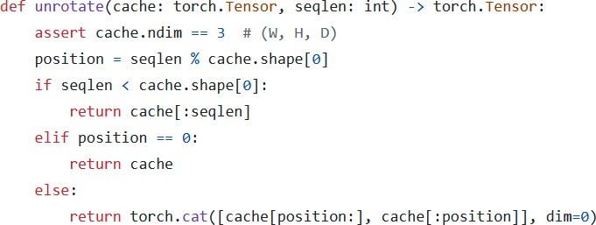
Rolling Buffer Cache: How It Works
Imagine we want to “unroll” the cache because we want to calculate the attention of the incoming token. It’s very easy! We just need to use the write pointer to understand how to order the items: we first take all the items AFTER the write pointer, and then all the items from the 0th index to the position of the write pointer.
A | CAT | IS | ON
Write pointer
CAT | IS | ON | A
Since the cache is not full yet, ignore unfilled items.
Since the cache is not full yet, ignore unfilled items. Rotate the cache around the write pointer

Slide 49
Pre-fill and chunking
When we generate text, we first feed the prompt and then predict new tokens one-by-one.
With a KV-cache we must load all prompt tokens into the cache before generation.
Pre-fill – because the prompt is known in advance, we insert its tokens directly into the cache.
Problem – loading a very long prompt in one shot creates an N × N attention matrix that may not fit in GPU memory.
Chunking – split the prompt into chunks of size W (the sliding-window length) and load them sequentially; only the current W × W slice is ever materialised.
Example (W = 4, each word = one token)
Prompt: “Can you tell me who is the richest man in history”

Slide 50
Pre-fill and chunking: first chunk
Prompt: “Can you tell me who is the richest man in history”
The KV-Cache
 | CAN | YOU | TELL | ME
CAN | 0.268 | −∞ | −∞ | −∞
YOU | 0.124 | 0.278 | −∞ | −∞
TELL | 0.147 | 0.132 | 0.262 | −∞
ME | 0.132 | 0.128 | 0.206 | 0.212
At every step, we calculate the attention using the tokens of the KV-Cache + the tokens of the current chunk as Keys and Values, while only the tokens of the incoming chunk as Query.
During the first step of pre-fill, the KV-Cache is initially empty.
After calculating the attention, we add the tokens of the current chunk to the KV-Cache. This is different from token generation in which we first add the previously-generated token to the KV-Cache and then calculate the attention. We will see layer why.
The attention
mask

Slide 51
Pre-fill and chunking: second chunk
Prompt: “Can you tell me who is the richest man in history”
The KV-Cache
CAN | YOU | TELL | ME
 | CAN | YOU | TELL | ME | WHO | IS | THE | RICHEST
WHO | −∞ | 0.132 | 0.262 | 0.132 | 0.951 | −∞ | −∞ | −∞
IS | −∞ | −∞ | 0.956 | 0.874 | 0.148 | 0.253 | −∞ | −∞
THE | −∞ | −∞ | −∞ | 0.132 | 0.262 | 0.259 | 0.456 | −∞
RICHES T | −∞ | −∞ | −∞ | −∞ | 0.132 | 0.687 | 0.159 | 0.357
You may have noticed that the size of the attention mask is bigger than the size of the KV-Cache. This is done on purpose, otherwise the newly added tokens will not have their dot products calculated with items that were previously in the cache (for example the word “Who” will not have its attention calculated with the previous tokens). This mechanism is only used during pre-fill of the prompt.
Why do we do like this? Because the KV-Cache has a fixed size, but at the same time we need all these attentions computed.
The attention
mask
Let’s review how this is implemented in code

Slide 52
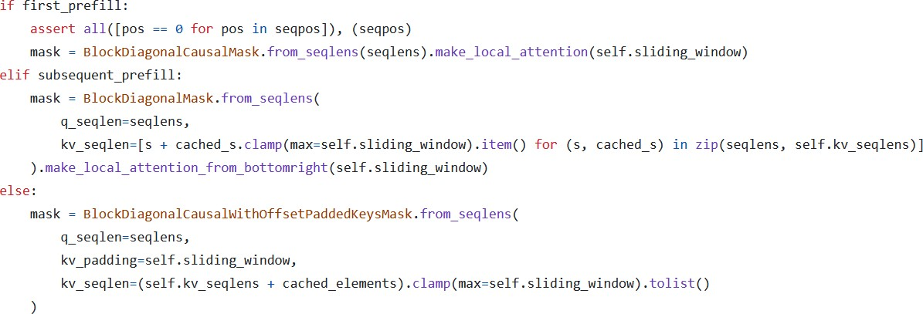
Pre-fill and chunking: code reference
Only during prefill the attention is calculated using an attention mask that is bigger than the KV-Cache.
As you can see, during the prefill of the first chunk and the subsequent chunks, we use the size of the KV-Cache and the number of tokens in
the current chunk to generate the attention mask.
During pre-fill, the attention mask is calculated using the KV-Cache + the tokens in the current chunk, so the size of the attention mask can be bigger than that of the KV-Cache (W).
During generation, we first add the previous token to the KV-Cache and then use the contents of the KV-Cache to generate the attention mask. During generation, the size of the attention mask is the size of the KV-Cache (W).
First chunk (KV-Cache is empty)
Subsequent chunks (KV-Cache is not empty)
Token generation

Slide 53
Pre-fill and chunking: last chunk
Prompt: “Can you tell me who is the richest man in history”
The KV-Cache
WHO | IS | THE | RICHEST
 | WHO | IS | THE | RICHEST | MAN | IN | HISTOR Y
MAN | −∞ | 0.132 | 0.262 | 0.132 | 0.951 | −∞ | −∞
IN | −∞ | −∞ | 0.956 | 0.874 | 0.148 | 0.253 | −∞
HISTOR Y | −∞ | −∞ | −∞ | 0.132 | 0.262 | 0.259 | 0.456
The last chunk may be smaller, that’s why we have less rows.
The attention
mask

Slide 54
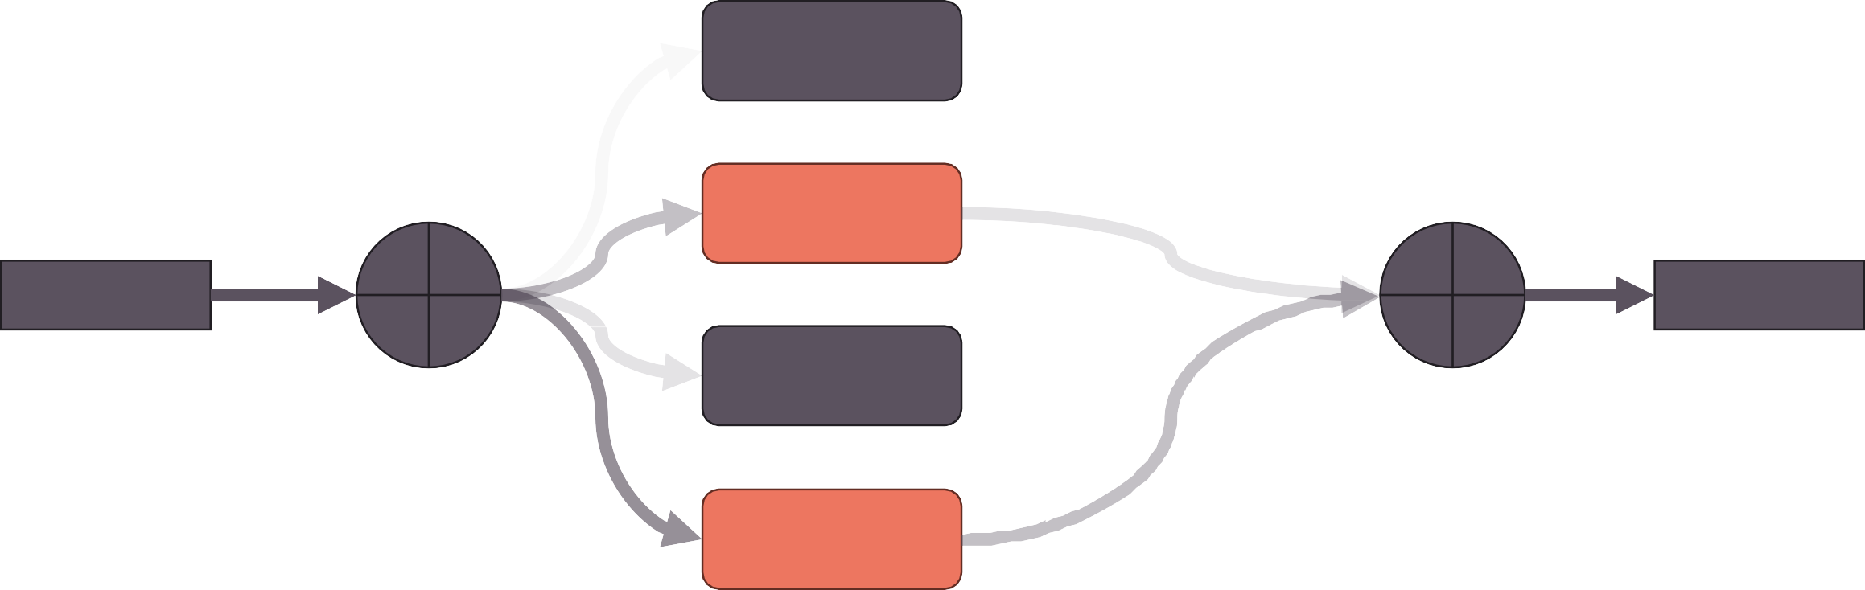
Mixture of Experts: An Introduction
Mixture of Experts is an ensemble technique, in which we have multiple “expert” models, each trained on a subset of the data, such that each model specializes on it and then the output of the experts are combined (usually a weighted sum or by averaging) to produce one single output.
In the case of Mistral 8x7B, we talk about Sparse Mixture of Experts (SMoE), because only 2 out of 8 experts are used for every token. The gate produces logits which are used to select the top-k experts. The top-k logits are then run through a softmax to produce weights.
0.6
Expert 1
Gate
1.5
Expert 2
Weighted Sum
40%
Input
Output
1.2
Expert 3
60%
3.4
Expert 4
*Numbers are randomly generated

Slide 55


Mistral 8x7B: Expert Feed-Forward Layers
In the case of Mistral 8x7B, the experts are the Feed-Forward layers present at every Encoder layer. Each Encoder layer is comprised of a single Self-Attention mechanism, followed by a mixture of experts of 8 FFN. The gate function selects the top 2 experts for each incoming token. The output is combined with a weighted sum.
This allows to increase the parameters of the model, but without impacting the computation time, since the input will only pass through the top 2 experts, so the intermediate matrix multiplications will be performed only on the selected experts.
Weighted Sum
(MoE) Feed Forward
SILU
8xfeed-forward layers
Gate
RMS Norm
Self-Attention with Sliding Window Attention
,Grouped Query Attention, and Rolling Buffer KV- Cache
Q K
V
RMS Norm

Slide 56
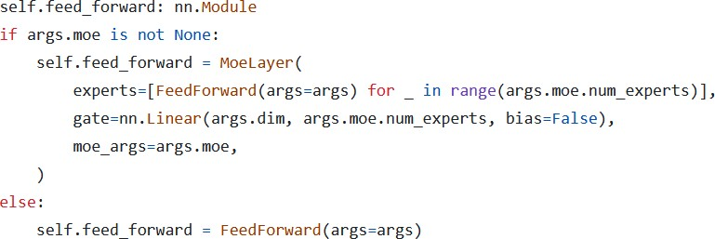
Mistral 8x7B : The Gating Function
The gating function is just a linear layer (in_features=4096, out_feature=8, bias=False) that’s trained along with the rest of the model.
For each token embedding, it produces 8 logits, which indicate which expert to select.
Mistral 8x7B
Mistral 7B

Slide 57
Mixture-of-Experts: why soft-max after the top-k gate?
If we apply the SoftMax directly to the output of the gate function, this will result in a “probability distribution” (weights that sum up to 1) over all the experts. But since we are only going to use the top-k of them, we want a “probability distribution” over only the selected experts.
This also makes it easier to compare two models trained on different number of experts, since the sum of the weights applied to the output will always be 1 independently on the number of experts chosen by the gate function.

Slide 58
Model Sharding
When we have a model that is too big to fit in a single GPU, we can divide the model into “groups of layers” and place each group of layers in a GPU.
When we inference iteratively: the output of each GPU is fed as input to the next GPU, and so on…
This technique is known as model sharding.
In the case of Mistral, since we have 32 Encoder layers, if we have 4 GPUs, we can store 8 of them in each GPU.
Embeddings
LAYER 1
LAYER 8
LAYER 9
LAYER 16
LAYER 17
LAYER 24
LAYER 25
LAYER 32
Linear Layer + Softmax
GPU 1
Layer 1 … 8
GPU 2
Layer 9 … 16
GPU 3
Layer 17 … 24
GPU 4
Layer 25 … 32
A pipeline like this one works fine, but it is not very efficient, because at any time only one GPU is working. A better approach (not implemented in the open-source release of Mistral), used especially during training, is to work on multiple batches at the same time, but shift them on the time scale. This approach is known as Pipeline Parallelism. Let’s see how it works.

Slide 59
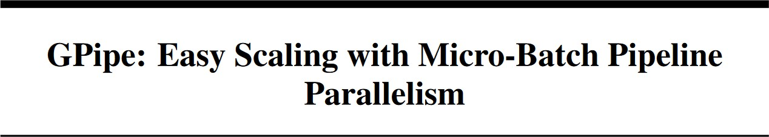
Pipeline Parallelism

Slide 60
Pipeline Parallelism: The Problem
Imagine we want to train our sharded model on a single batch: it will take 8 timesteps to do it, and at each time step, only one GPU is working while the others are waiting idle.
Timestep | 0 | 1 | 2 | 3 | 4 | 5 | 6 | 7
GPU 4 |  |  |  | FORWARD | BACKWARD
GPU 3 |  |  | FORWARD |  |  | BACKWARD
GPU 2 |  | FORWARD |  |  |  |  | BACKWARD
GPU 1 | FORWARD |  |  |  |  |  |  | BACKWARD

Slide 61
Pipeline Parallelism: The Solution
We divide our batch into smaller microbatches, and shift each microbatch’s forward and backward step on the timeline.
Each timestep in this case takes less, since we are working on a small microbatch. The gradients for each microbatch is accumulated
(gradient accumulation) and then we can run the optimizer to update the weights.
Timestep | 0 | 1 | 2 | 3 | 4 | 5 | 6 | 7 | 8 | 9 | 10 | 11 | 12 | 13
GPU 4 |  |  |  | FW-1 | FW-2 | FW-3 | FW-4 | BCW-4 | BCK-3 | BCK-2 | BCK-1
GPU 3 |  |  | FW-1 | FW-2 | FW-3 | FW-4 |  |  | BCW-4 | BCK-3 | BCK-2 | BCK-1
GPU 2 | FWD-1 |  | FW-2 | FW-3 | FW-4 | Bubble |  |  |  | BCW-4 | BCK-3 | BCK-2 | BCK-1
GPU 1 | FWD-1 | FW-2 | FW-3 | FW-4 |  |  |  |  |  |  | BCW-4 | BCK-3 | BCK-2 | BCK-1
We still have timesteps in which not all GPUs are working (called “bubbles”). To avoid bubbling, we can increase the size of the batch

Slide 62
Understanding the Mistral model’s code
Block Attention in xformers

Slide 63
Optimizing Inference with Multiple Prompts
Imagine you are running an AI company providing LLM inference service: you have many customers that send their prompts and want to run inference on your models. Each prompt may have a different lengths. For simplicity, suppose that each word is a token.
Consider the following prompts:
Prompt 1: “Write a poem” (3 tokens)
Prompt 2: “Write a historical novel” (4 tokens)
Prompt 3: “Tell me a funny joke” (5 tokens)
If we want to fully exploit our GPU, we should put all the prompts in a batch, but since they have different lengths, we have to pad them with a [PAD] token, and when the model produces the output, we should only look at the output corresponding to the last non-padding token, discarding any future tokens.
Write | a | poem | [PAD] | [PAD]
Write | a | historical | novel | [PAD]
Tell | me | a | funny | joke
LLM
TOK1_1 | TOK1_2 | TOK1_3 | TOK1_4 | TOK1_5
TOK2_1 | TOK2_2 | TOK2_3 | TOK2_4 | TOK2_5
TOK3_1 | TOK3_2 | TOK3_3 | TOK3_4 | TOK3_5
Linear Layer + Softmax

Slide 64
Optimizing Inference with Multiple Prompts
Write | a | poem | [PAD] | [PAD]
Write | a | historical | novel | [PAD]
Tell | me | a | funny | joke
LLM
TOK1_1 | TOK1_2 | TOK1_3 | TOK1_4 | TOK1_5
TOK2_1 | TOK2_2 | TOK2_3 | TOK2_4 | TOK2_5
TOK3_1 | TOK3_2 | TOK3_3 | TOK3_4 | TOK3_5
Linear Layer + Softmax
To select the next token to generate, we will check the embedding corresponding to the last non-padding token, which are highlighted in
the output above. Because our modal is an LLM, we will apply a causal mask. This mask works fine for all the three sequences.
We cannot use a different mask for each prompt, because all the prompts
are of the same length, so the mask must be 5x5 for each prompt!
0 | −∞ | −∞ | −∞ | −∞
0 | 0 | −∞ | −∞ | −∞
0 | 0 | 0 | −∞ | −∞
0 | 0 | 0 | 0 | −∞
0 | 0 | 0 | 0 | 0
The problem here is that we are calculating a lot of dot products, especially for the first
and the second prompt that will not be used! Let’s see with an example.

Slide 65
Optimizing Inference with Multiple Prompts
All the useless dot-products are highlighted in red.
 | WRITE | A | POEM | [PAD] | [PAD]
WRITE | 0.268 | −∞ | −∞ | −∞ | −∞
A | 0.124 | 0.278 | −∞ | −∞ | −∞
POEM | 0.147 | 0.132 | 0.262 | −∞ | −∞
[PAD] | 0.210 | 0.128 | 0.206 | 0.212 | −∞
[PAD] | 0.146 | 0.158 | 0.152 | 0.143 | 0.227
 | WRITE | A | HISTORI CAL | NOVEL | [PAD]
WRITE | 0.268 | −∞ | −∞ | −∞ | −∞
A | 0.124 | 0.278 | −∞ | −∞ | −∞
HISTORI CAL | 0.147 | 0.132 | 0.262 | −∞ | −∞
NOVEL | 0.210 | 0.128 | 0.206 | 0.212 | −∞
[PAD] | 0.146 | 0.158 | 0.152 | 0.143 | 0.227
 | TELL | ME | A | FUNNY | JOKE
TELL | 0.268 | −∞ | −∞ | −∞ | −∞
ME | 0.124 | 0.278 | −∞ | −∞ | −∞
A | 0.147 | 0.132 | 0.262 | −∞ | −∞
FUNNY | 0.210 | 0.128 | 0.206 | 0.212 | −∞
JOKE | 0.146 | 0.158 | 0.152 | 0.143 | 0.227
There is also the problem of the KV-Cache: each prompt may have a different KV-Cache size (imagine one prompt with only 10 tokens and another one with 500 tokens!). We must find a better solution!

Slide 66
Combining Multiple Prompts Into A Single Sequence
The solution is to combine all the tokens of all the prompts into a single sequence and keep track of the length of each prompt when we calculate the output.
Write | a | poem | Write | a | historical | novel | Tell | me | a | funny | joke
LLM
TOK1_1 | TOK1_2 | TOK1_3 | TOK2_1 | TOK2_2 | TOK2_3 | TOK2_4 | TOK3_1 | TOK3_2 | TOK3_3 | TOK3_4 | TOK3_5
Linear Layer + Softmax
You may be wondering: how do we build an attention mask for such a sequence? Simple! We use xformers BlockDiagonalCausalMask!

Slide 67
xformers BlockDiagonalCausalMask
The mask may be different in case we use Sliding Window Attention.
Let’s have a look at the code!
 | Write | a | poem | Write | a | histori cal | novel | Tell | me | a | Funny | joke
Write | 0 | −∞ | −∞ | −∞ | −∞ | −∞ | −∞ | −∞ | −∞ | −∞ | −∞ | −∞
a | 0 | 0 | −∞ | −∞ | −∞ | −∞ | −∞ | −∞ | −∞ | −∞ | −∞ | −∞
poem | 0 | 0 | 0 | −∞ | −∞ | −∞ | −∞ | −∞ | −∞ | −∞ | −∞ | −∞
Write | −∞ | −∞ | −∞ | 0 | −∞ | −∞ | −∞ | −∞ | −∞ | −∞ | −∞ | −∞
a | −∞ | −∞ | −∞ | 0 | 0 | −∞ | −∞ | −∞ | −∞ | −∞ | −∞ | −∞
histor ical | −∞ | −∞ | −∞ | 0 | 0 | 0 | −∞ | −∞ | −∞ | −∞ | −∞ | −∞
novel | −∞ | −∞ | −∞ | 0 | 0 | 0 | 0 | −∞ | −∞ | −∞ | −∞ | −∞
Tell | −∞ | −∞ | −∞ | −∞ | −∞ | −∞ | −∞ | 0 | −∞ | −∞ | −∞ | −∞
me | −∞ | −∞ | −∞ | −∞ | −∞ | −∞ | −∞ | 0 | 0 | −∞ | −∞ | −∞
a | −∞ | −∞ | −∞ | −∞ | −∞ | −∞ | −∞ | 0 | 0 | 0 | −∞ | −∞
funny | −∞ | −∞ | −∞ | −∞ | −∞ | −∞ | −∞ | 0 | 0 | 0 | 0 | −∞
joke | −∞ | −∞ | −∞ | −∞ | −∞ | −∞ | −∞ | 0 | 0 | 0 | 0 | 0

Slide 68
Thank You
(Q&A)

